Slide 1

Build Spider on Cloud
Workshop presented by Hall 2 IT team
Github repo: https://goo.gl/rvHcGB

Slide 2
Quick Survey
Notes:
Survey on coding experience, python experience, how many people need access to remote server

Slide 3
Get started
This workshop is given in Python 2, if you wish to work in your local pc, please make sure you’ve have following modules installed:
selenium
phantomjs
requests
BeautifulSoup4
Jupyter Notebook
Examples on how you install those packages:
(Mac/Linux): pip install selenium
(Windows with anaconda): conda install -c conda-forge selenium
Consider using your local PC first. If you couldn’t satisfy the requirements, please follow next few slides
Notes:
Tell them to wok on their local PC if possible, help install the package
brief intro on ssh tunnelling to those who don’t have python installed and need to work on the remote server
tell them to pay attention to share /resource/notification.doc in the google drive, for dynamic commands would be post there. Participants just need to copy and paste it to terminal/cmd

Slide 4
Set up tunnel to remote server
Go to “https://drive.google.com/open?id=0Bx06sggvEI3MYnpCM2doYWM4c0k”
Download the key depending on your Operating system
Windows : window_key.ppk
Mac : mac_key.pem
Please open the google form within the folder, we would post commands, url to you interactively.
Notes:
State the .ppk and .pem differences

Slide 5
Mac User
Open terminal
type in command:
ssh -i [path to the downloaded key] -fN [your user name]@[IP address to the server] -L 1234:localhost:1234
Open browser and go to page “localhost:1234”
Go to your folder according to your user name

Slide 6
Windows User
Download putty.zip in the google share folder
Open CMD and go to the path containing plink.exe
Type in Command
plink -i [path to your key] -L 1234:localhost:1234 [your user name]@[server IP address]
Open browser and go to page “localhost:1234”
Go to your folder according to your user name
Notes:
Warn them to move the directory of CMD to the folder that contained plink.exe
IMPORTANT, make sure that everyone is in their relative folder, so that each user use independent ipython notebook
Make sure everything all set

Slide 7
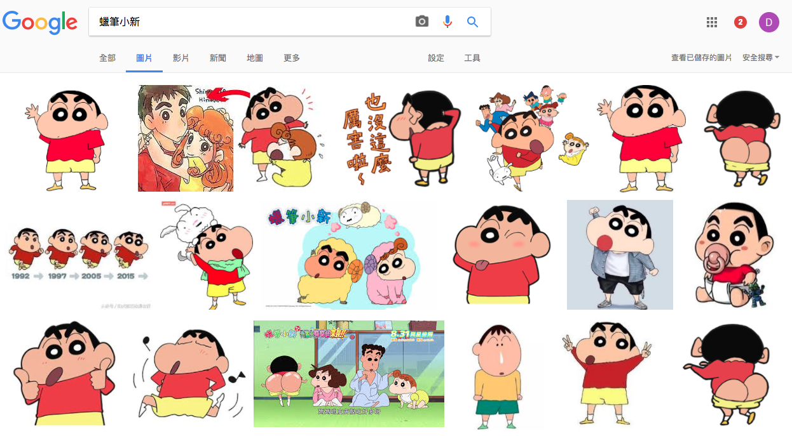
Have you ever come to ...
BUT, right click to save all images are just too tedious
Notes:
a situation that you want to download large amount of images, bring out several examples

Slide 8
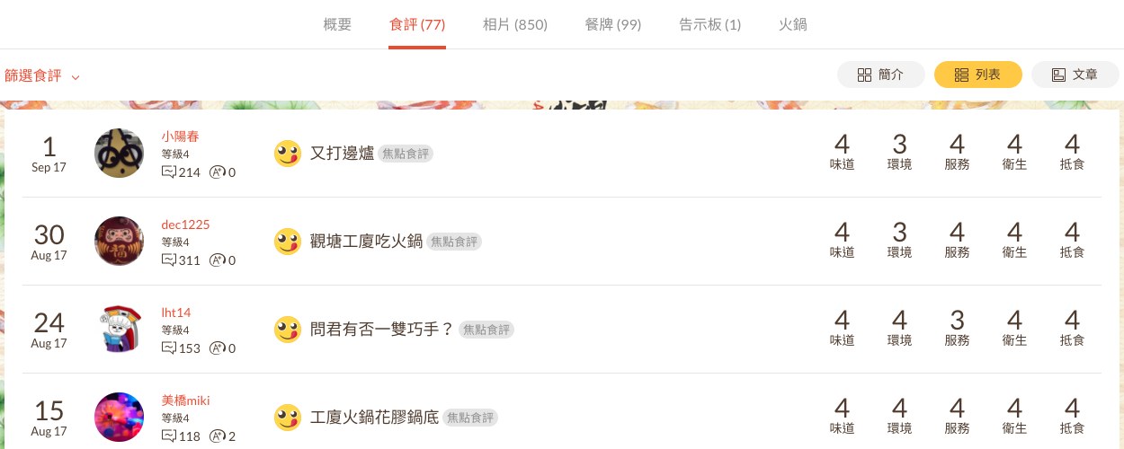
Or you wish to collect the rating of a store
There are hundreds of them, still tedious...
Notes:
or you want to save the ratings of a restaurant for further used

Slide 9
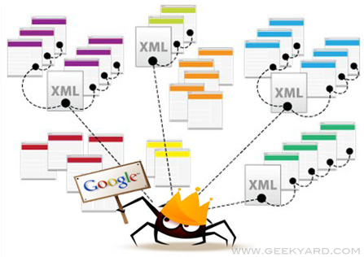
What is Spider / Crawler / Scaper ?
Extract useful information (e.g. text, images) directly from the source of website
Notes:
In all those cases, collecting data manually would be dull and boring, therefore, we need help from spider, which is basically a set of code help you to retrieve those needed data

Slide 10

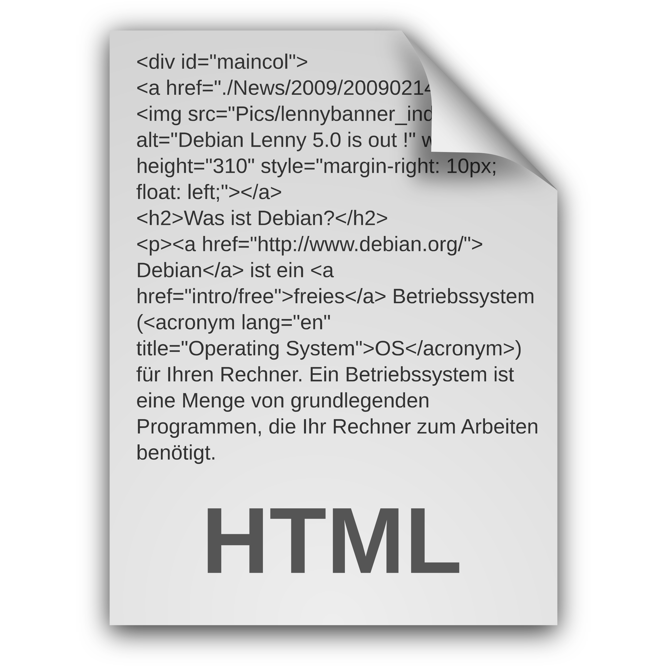


How browsers render websites
Browser
Server
Request
Notes:
explain the process of rendering a webpage and bring out the topic of html code

Slide 11
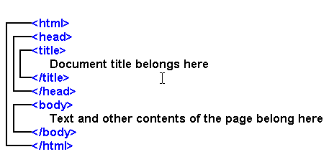

How a spider works?
Server
Request
Notes:
Spider directly look at the source of website and retreive needed information

Slide 12
Brief Introduction on HTML code
Hypertext Markup Language (HTML) is the main language for writing webpages.
<tag> and examples
HTML Attributes

Slide 13
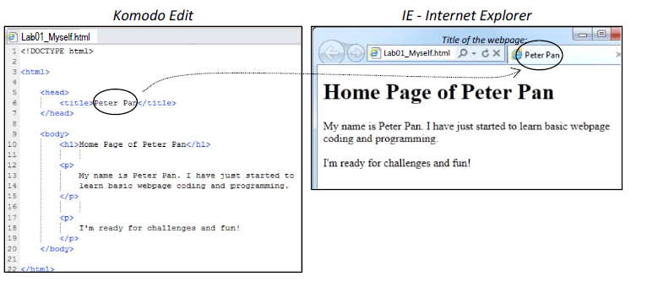
Tags
In an html file, all html contents are enclosed between the start and end tags.
<html> </html>

Slide 14
Head section and body section

Slide 15
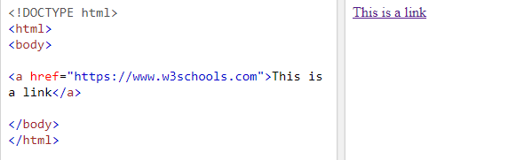
<h1></h1>
<p></p>
<a></a>
We can add a hyperlink using the <a> element.
To specify a web address, we provide the reference attribute href=".." in the start tag <a >.

Slide 16
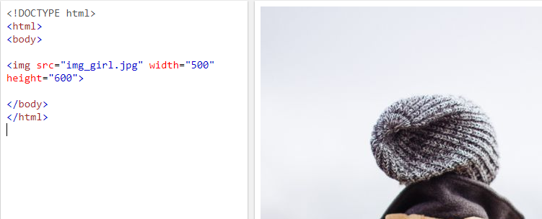
<h1></h1>
<p></p>
<a></a>
<img></img>
HTML images are defined with the <img> tag.
The filename of the image source is specified in the src attribute:

Slide 17
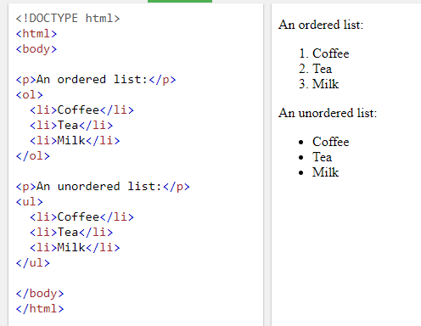
<h1></h1>
<p></p>
<a></a>
<img></img>
<li></li>
The <li> tag defines a list item.
The <li> tag is used in ordered
lists(<ol>), unordered lists (<ul>),
and in menu lists (<menu>).

Slide 18
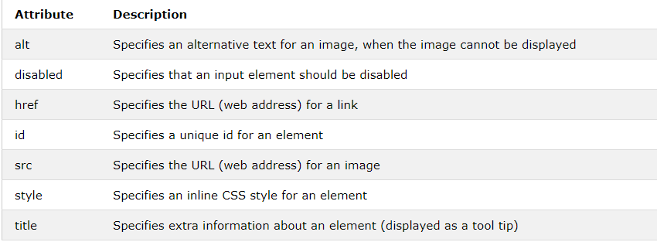
HTML Attributes

Slide 19
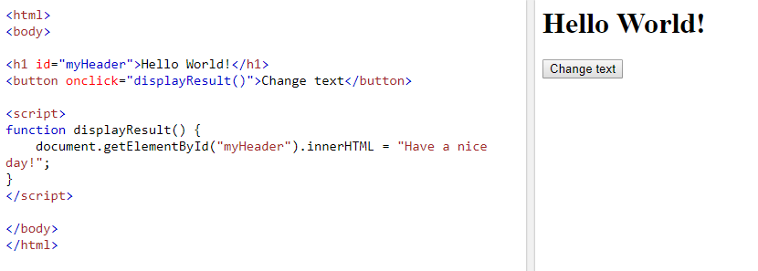
id

Slide 20
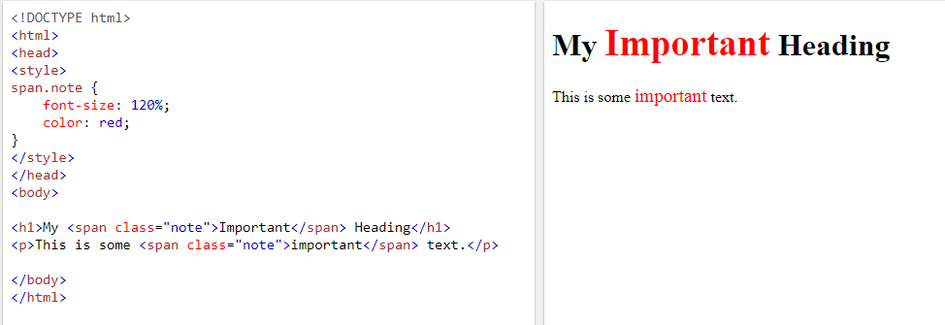
Class
The HTML class attribute makes it possible to define equal styles for elements with the same class name.

Slide 21
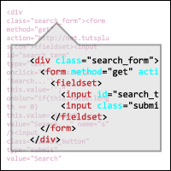
How we extract information from those raw sources?

Slide 22
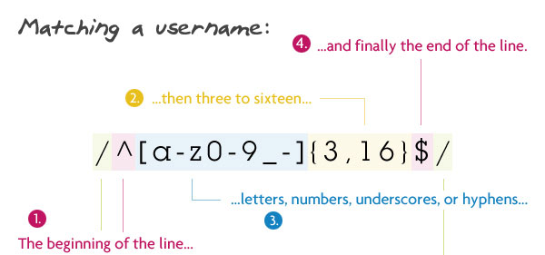
What is Regular Expression?
Abbreviated as “Regex”
A sequence of symbols and characters used for pattern-matching
Useful for extrating information from text, such as email address, html tags, url…
Widely applicable in different programming languages
https://code.tutsplus.com/tutorials/8-regular-expressions-you-should-know--net-6149
Notes:
Might mention Chomsky Hierarchy (4 types of formal language): Regular Language, Context-free Language, Context-sensitive Language, Unrestricted Language

Slide 23
Regex Cheatsheet!
Reference website: https://regexr.com
Character Classes | Quantifiers & Alternation | Groups & Lookaround
. any character except newline \w \d \s word, digit, whitespace \W \D \S not word, digit, whitespace [abc] character set (any of a, b, c) [^abc] negated set (not a, b, c) [a-g] range (any between a- g) | a* 0 or more a+ 1 or more a? 0 or 1 a{3} match exactly 3 a{3,} match 3 or more a{1,3} match between 1 to 3 a+? match as few as possible (lazy) a|b match a or b | (abc) capture group \1 back-reference to group 1 (?:abc) non-capturing group (?=abc) positive lookahead (?! abc) negative lookahead
Escaped Characters | Anchors | Flags
\. \* \\ escaped special characters \t \n tab, line | ^abc start of a string abc$ end of a string \b word boundary \B not word boundary | re.I ignore case re.M multiline re.S dot matches all including newline

Slide 24
Regex in Python
re.findall: return all matches as a “list” of strings
re.search: scan for the first match, return MatchObject or None
re.match: match at the beginning of the string, return MatchObject or None
re.findall/search/match (pattern, string, flag=0)
re.compile: compile the pattern in a “regex object”, convenient for repeated use
prog = re.compile (pattern)
result= prog.findall/search/match (string)

Slide 25
Work through in Jupyter notebook
Work through the entire concept covered in previous slides, and a basic framework of a Crawler
header
dynamic webiste with javascript rendering
exception handling
crawling
requests
received data
parse the raw source with a) regular expression b) packages BeautifulSoup4
write the data to file

Slide 26
Summary
Even though spider is COOL, we shouldn’t consider using spider in the first place, very often there are packed rar file, api, or tools for you to download data. You only use spider when there’s no other choice
Website are constructed by human, therefore, there must have some logic in it and we should build our spider case by case.

Slide 27
Build your own crawler base on the given example
Try Yourself ~
Notes:
tell them to find a website themselves and try to adapt the given code and crawl back some information
feedback form

Slide 28

Promotion of the CityU first HACKATHON!!!

Slide 29

Please help us Improve

